Slide 1
Notes:
Pamela Valentine -Welcome

Slide 2

#PROMS
#ECTRIMS2019
#MultipleSclerosis

Slide 3


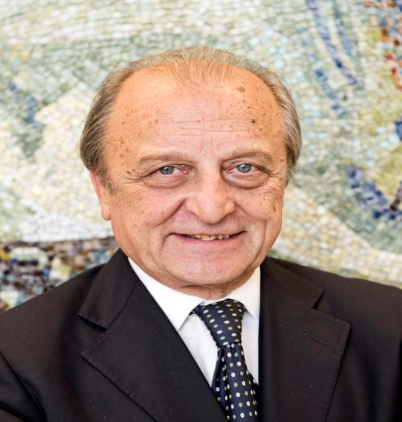
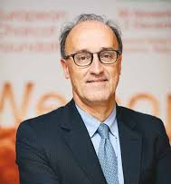

Members of the panel
Peer Baneke, UK
Multiple Sclerosis International Federation
(CEO)
Mario Alberto
Battaglia, Italy
Italian Multiple Sclerosis
Society Foundation
(President)
Giancarlo Comi, Italy
European Charcot Foundation (President)
Patrick Vermersch, France
European Charcot Foundation
(Board Member)
Moderator:
Pamela Valentine, Canada
MS Society of Canada
(President & CEO)
Notes:
Pamela Valentine . Introduction of the Members of Panel

Slide 4





PATIENT REPORTED OUTCOME
CALL TO ACTION
MSIF 2017-2021 Strategy
Multistakeholders
PRO Lerici’s meeting
MSIF Lead Agency
Notes:
Peer Baneke. A global and multistakeholders initiative

Slide 5


MSIF 2017-2021 STRATEGY
MSIF Lead Agency
“Global collaborations for registries or databases in relation to Patient Reported Outcomes”
Notes:
Peer Baneke. Meeting MSIF 2017-2021 Strategy

Slide 6
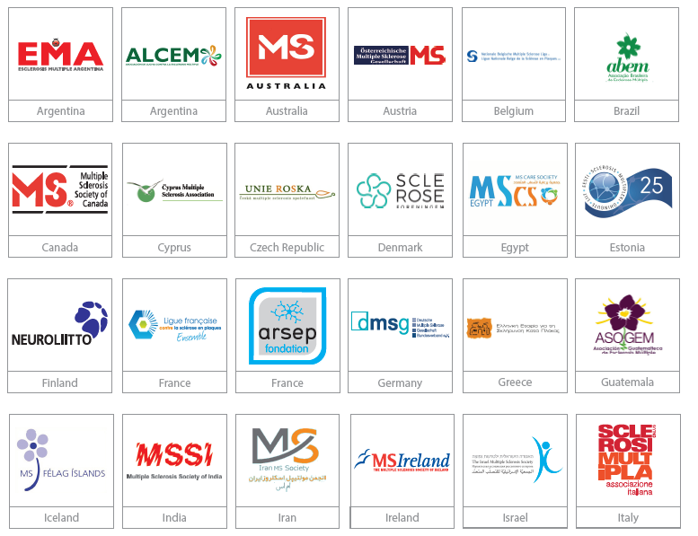

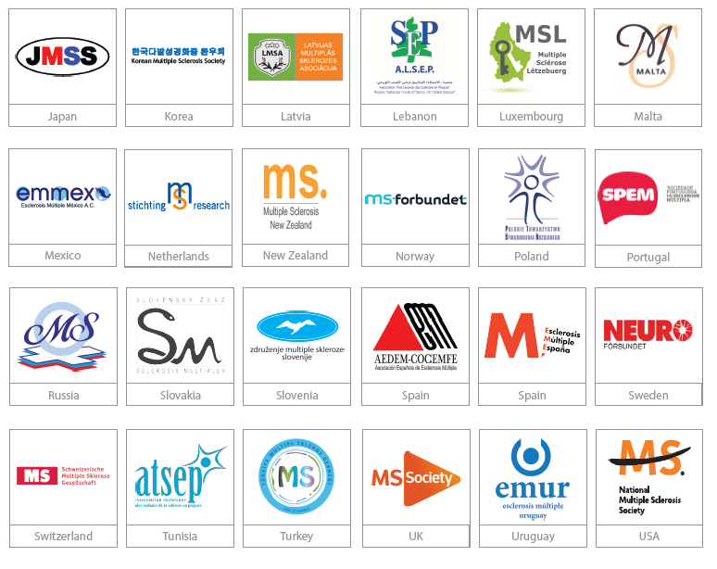







MS SOCIETIES AND CURRENT IPRO PARTNERSHIP
MSIF LEAD AGENCY: ITALIAN MS SOCIETY
TM
Notes:
Peer Baneke. MS Societies and Current iPRO Partnership MSIF. Lead Agency: Italian MS Society

Slide 7
AISM Lead Agency
Contributing to the Patient Registry Initiative promoted by EMA
PROs for MS research and healthcare. AISM is working on an international project to standardize and harmonize PROs between their own PROMOPRO-MS database and iConquerMS (Accelerated Cure Project) network.
International experience in applying framework for Multistakeholder Research Initiatives (coordinator of EU H2020 Responsible Research Innovation MULTI-ACT project)
Notes:
Mario Alberto Battaglia. How PROMS is in line with what is happing in initiatives engaging Italy and Italian MS Societies?

Slide 8

PATIENT REGISTRY INITIATIVE
Regulatory authorities
Pharmaceutical companies
Registry holders/academia
Aim
To explore ways of increasing use of patient registries by supporting a more systematic and standardised approach to their contribution to the benefit-risk evaluation of medicines
http://www.ema.europa.eu/ema/index.jsp?curl=pages/regulation/general/general_content_000658.jsp
Patient Representatives to:
“Advise on appropriate patient reported outcomes that might feasibly be collected and included in registries”
7th July 2017
- Multiple sclerosis workshop -
Notes:
Mario Alberto Battaglia. EMA recommendation: Patient Representatives to “Advise on appropriate patient reported outcomes that might feasibly be collected and included in registries”

Slide 9

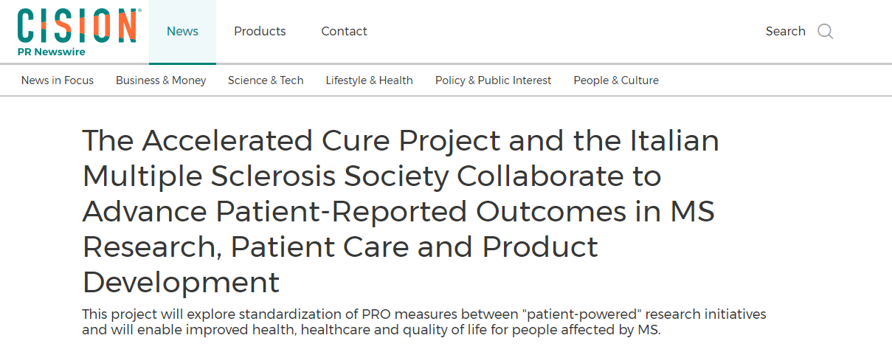

PROOF OF CONCEPT STUDY – iConquer MS – PROMOPROMS
30th May, 2018
TM
Notes:
Mario Alberto Battaglia. The collaboration with Accelarated Cure: going beyond Europe

Slide 10
15th May, 2018
Notes:
Mario Alberto Battaglia. Need for a collective research impact framework

Slide 11



IMPACT OF RESEARCH ON PEOPLE WITH MS
The Mission: the explicit driverEOPLE WITH MS
The Mission: the explicit driver
Notes:
Mario Alberto Battaglia. Design with the end in mind. The mission (e.g. PROMS agenda) is the explicit driver (of MULTI-ACT framework) to impact on people with MS and the other stakeholders

Slide 12
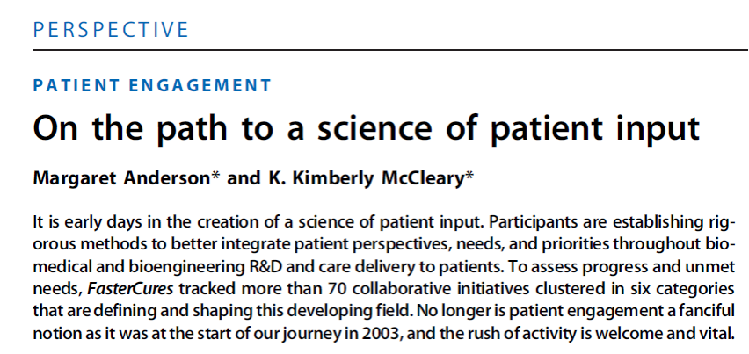

“WHAT MATTERS TO PATIENTS?”
2016
….What began as an extension of patient advocacy is now evolving into an emerging scientific discipline aimed at understanding and incorporating patient needs and perspectives into the processes of developing, regulating, and delivering new therapies as well as improving care….
Notes:
Patrick Vermersch. What matter to patients? Towards the agenda of PROMS Initiative: Lerici’s meeting outcomes and strategic objectives.

Slide 13
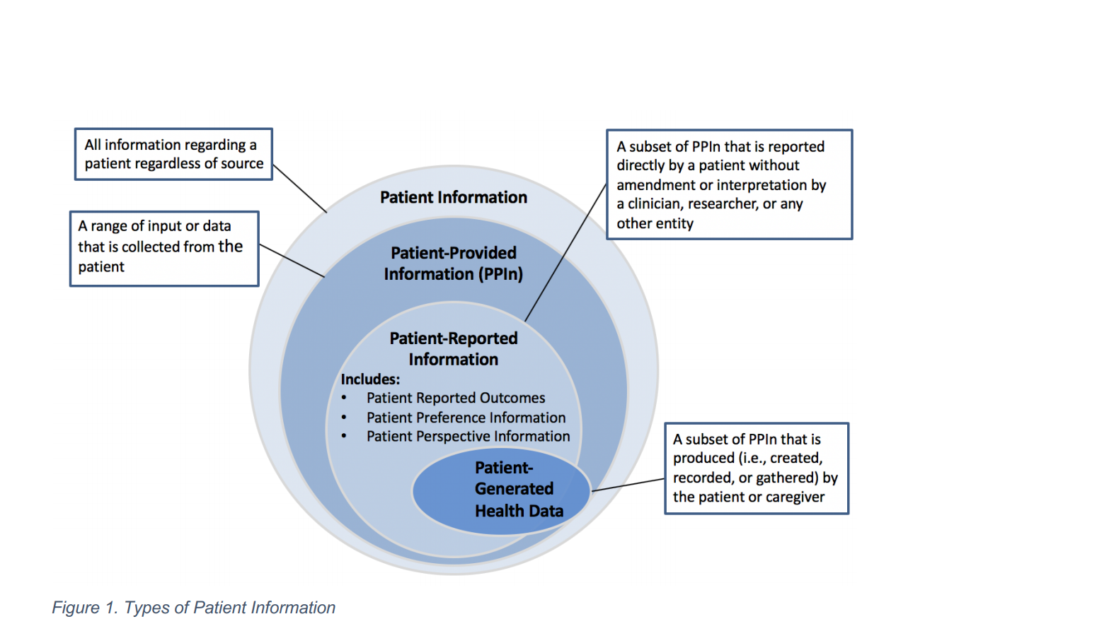
PATIENT-PROVIDED INFORMATION (PPIN)
(https://www.nationalhealthcouncil.org/sites/default/files/NHC_Patient_Engagement_Rubric.pdf)
Notes:
Patrick Vermersch. Patient-provided information include PRO

Slide 14
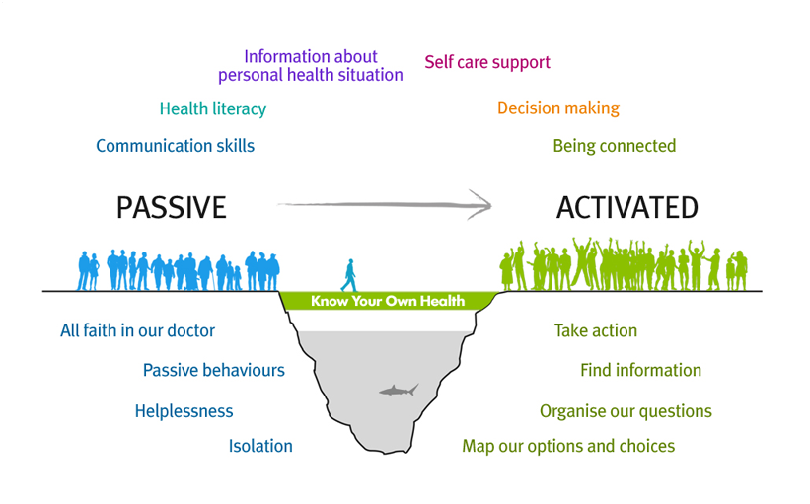
THE FUTURE OF PATIENTS:
“EMPOWERING EXPERIENTIAL KNOWLEDGE”
Science with/of Patient Input
(Adapted from David Somekh , European Health Management Association, 2016
Notes:
Patrick Vermersch. Science with/of Patient Input are instrumental to empower experiential knowledge

Slide 15
MULTI-STAKEHOLDER MEETING – LERICI, JULY 2018
HIGH LEVEL OUTCOME
Several global initiatives are defining and shaping this developing field
However, despite differences in viewpoint, the different stakeholders agree that PRO and PROMs have not reached their full potential of delivering benefits to patients
Notes:
Patrick Vermersch. Lerici’s meeting high level outcome

Slide 16
STAKEHOLDERS ATTENDING LERICI MEETING, JULY 2018
MS Organizations
Research and education organizations
Academia
Care
providers
Industry
Notes:
Patrick Vermersch. Lerici’s meeting: cathegories stakeholders that attended the meeting

Slide 17
MULTI-STAKEHOLDER MEETING – LERICI, JULY 2018
RESEARCH, VALIDATION AND DEVELOPMENT:
STRATEGIC OBJECTIVES
To identify functional domains that matter most to people with MS that will lead to the prioritization of functional domains. This is particularly important for ensuring content validity
To fill critical gaps in the knowledge base that are hindering progress toward the development of a clear roadmap for research needs and progress
To research, validate and develop relevant PROMs
Notes:
Patrick Vermersch. Lerici’s meeting: priority areas and strategic objectives

Slide 18
MULTI-STAKEHOLDER MEETING – LERICI, JULY 2018
CLINICAL MANAGEMENT: STRATEGIC OBJECTIVES
To identify current PROs and PROMs to be used in clinical care and collected in registries and advice relevant regulatory agencies and clinicians.
Meet regulatory agencies position on PRO and PROMs (e.g. MSOAC EMA document)
To promote, coordinate, implement and support initiatives aiming at validating and harmonizing PROs across cultures
Notes:
Patrick Vermersch. Lerici’s meeting: priority areas and strategic objectives

Slide 19
MULTI-STAKEHOLDER MEETING – LERICI, JULY 2018 e-HEALTH: STRATEGIC OBJECTIVES
To establish current e-Health return of investment for all the stakeholders engaged
To enable the long-term benefits afforded to patients (active versus passive), clinicians and other stakeholders by e-Health
Notes:
Patrick Vermersch. Lerici’s meeting: priority areas and strategic objectives

Slide 20
MULTI-STAKEHOLDER MEETING – LERICI, JULY 2018
HEALTH CARE SYSTEM: STRATEGIC OBJECTIVES
To translate standardized data into a performance measure (PRO-PMs) that captures the results most important for improving long-term wellness.
To enable PRO-PM in innovative reimbursement models, regulatory frameworks well as their clinical decision support algorithms.
Notes:
Patrick Vermersch. Lerici’s meeting: priority areas and strategic objectives

Slide 21
Global PRO Joint Initiative
MISSION
To maximize impact of Science with and of Patient Input on the health, healthcare and quality of life of people affected by MS.
To represent a unified view on PROs for MS to Healthcare Providers, Regulatory Agencies and Healthcare Technology Assessment Agencies (HTAs).
Notes:
G. Comi. PROMS Initiative: mission

Slide 22
Global PRO Joint Initiative
MULTISTAKEHOLDER INITIATIVE PRINCIPLES
The PROMS Initiative recognizes the crucial importance of a framework to guide effective Multistakeholder engagement.
As such, it will operate with respect for the values of ECF and MSIF, and will learn from best practice of other relevant initiatives (e.g. ECF Multistakeholder Initiative; Progressive MS Alliance and H2020 RRI MULTI-ACT project).
Notes:
G. Comi. PROMS Initiative: multistakeholder initiative principles

Slide 23
Global PRO Joint Initiative
KEY PRINCIPLES OF THE PROMS INITIATIVE
Clarity of purpose: the mission of the initiative is clearly defined, with people affected by MS at its heart.
Inclusivity. The initiative will aim to engage all parties/organizations from across the globe that have an interest in furthering the mission of the PROMS Initiative, and will:
  Learn from their relevant experience and work to date.
  Give them opportunity to shape the overall scientific agenda of the initiative.
Ensure that all stakeholders, including people with and affected by MS, have an equal voice.
Use a co-creation approach where possible.
Notes:
G. Comi. PROMS Initiative: multistakeholder initiative principles

Slide 24
EXECUTIVE COMMITTEE
OPERATIONAL SECRETARY
&
PROGRAM MANAGEMENT
SCIENTIFIC STEERING COMMITTEE
RESEARCH VALIDATION DEVELOPMENT
CLINICAL MANAGEMENT
eHEALTH DEVELOPMENT
HEALTHCARE SYSTEM
Notes:
G. Comi. PROMS Initiative: strategic direction

Slide 25

BRIDGING EXCELLENCE WITH VALIDITY AND RELEVANCE: IMPACT
WG1
RESEARCH VALIDATION DEVELOPMENT
WG2
CLINICAL MANAGEMENT
WG3
eHEALTH DEVELOPMENT
WG4
HEALTHCARE SYSTEM
  1. Fill gaps: new validated PRO and PROMs
  2. Uptaking PRO into clinical practice
  3. Validation of active and passive remote control
  4. Increase value of PRO in health care: relevance for the economic dimension
  MEASURING IMPACT ON OUTCOMES THAT MATTER MOST TO PATIENTS
Stakeholders Mapping
Stakeholders Mapping
Stakeholders Mapping
Stakeholders Mapping
AGENDA Objectives
………
AGENDA Objectives
………
AGENDA Objectives
………
AGENDA Objectives
………
Notes:
G. Comi. PROMS Initiative: expected outcomes

Slide 26
PROMS KEY STEPS
ECF - MSIF - AISM
MOU signed
First SSC Meeting Proposition Paper: Landscape and setting strategic priorities
Consensus
&
Dissemination
Alongside ECF Annual Meeting, Baveno
June 2019
November 2019
July 2022
Januari 2019
September 2019
Spring 2020
ECF - MSIF - AISM
Kick Off Meeting Milan
Public Announcement ECTRIMS Stockholm
Strategic WGs Meeting To define WGs agendas and composition
Notes:
PROMS Initiative: key steps

Slide 27
For more information please contact:
Paola Zaratin
paola.zaratin@aism.it
Jan Samyn
charcot@seauton-international.com

Slide 28
Questions?

